Slide 1



Domain-Driven Design: The Good Parts
Jimmy Bogard
@jbogard
github.com/jbogard
jimmybogard.lostechies.com

Slide 2
Part 1: The Majestic Monolith

Slide 3

Project Background
1 year spent building requirements documents
No software to show for it
1st agile project for Texas government agency
1st DDD project for Texas government agency

Slide 4
Previous System(s)
Fort Worth
Dallas
Everyone Else
Houston
Austin
San Antonio

Slide 5
New System
Fort Worth
Everyone Else
Dallas
JCMS
Austin
San Antonio
Houston

Slide 6
Project Goals
Increase knowledge sharing
Comprehensive system covering all aspects of juvenile process
Complete picture of juvenile process

Slide 7
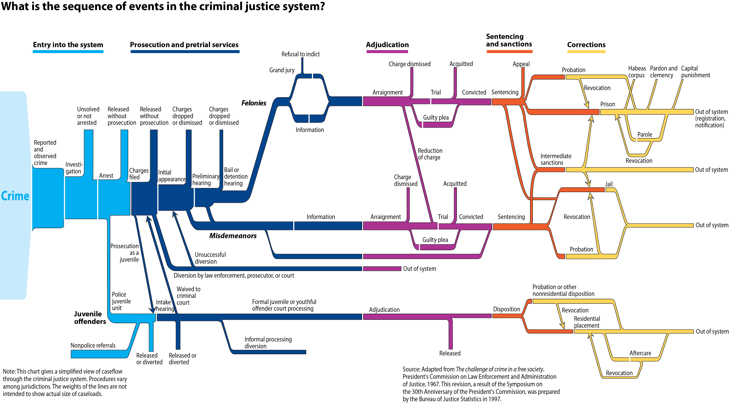

Slide 8
Cracks already showing: 72 personas
Pete Probation Officer
Percy Program Staff
Julie JPD Admin
Carl CRS Manager
Agnes Agency Admin
Samantha Substance Abuse
Larry Law Enforcement Officer
Nancy Nurse
Lucy LEA Approver
Ted Truancy Officer
Fred Fee Clerk
Patty Probation Officer with Disposition Priveleges
Dennis Detention Supervisor
Judy Judge
Ichibod Intake Supervisor
Curly Court Admin
Luann LEA Admin
Pam Prosecution Admin Clerk
Ivan Institutions Officer
Rose Records Management
Matt Mental Health
Andy Aftercare Officer
Andreas Auditor
Penny Chief Prosecutor

Slide 9
Color coded based on agencies
Pete Probation Officer
Percy Program Staff
Julie JPD Admin
Carl CRS Manager
Agnes Agency Admin
Samantha Substance Abuse
Larry Law Enforcement Officer
Nancy Nurse
Lucy LEA Approver
Ted Truancy Officer
Fred Fee Clerk
Patty Probation Officer with Disposition Priveleges
Dennis Detention Supervisor
Judy Judge
Ichibod Intake Supervisor
Curly Court Admin
Luann LEA Admin
Pam Prosecution Admin Clerk
Ivan Institutions Officer
Rose Records Management
Matt Mental Health
Andy Aftercare Officer
Andreas Auditor
Penny Chief Prosecutor

Slide 10
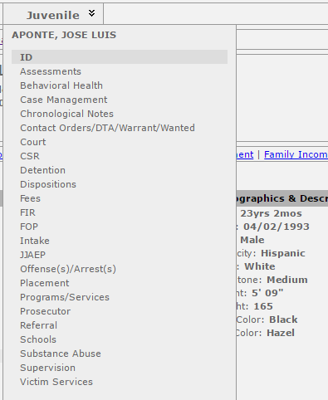
Lesson 1: Bounded contexts are a thing

Slide 11
Ambiguous Modeling
?
?
?
Person
?
?
?

Slide 12
Lesson 2: Ubiquitous Language should be ubiquitous

Slide 13
Competing Priorities
LEA
Prosecution
Offense/Arrest!
Case!
Trial!
Juvenile!
Courts
JPD

Slide 14
Lesson 3: Core Domain needs consensus

Slide 15
Competing Models
LEA
Prosecution
Form CR-23J
Something to charge for
Something to adjudicate
Something to move past
Courts
JPD

Slide 16
Lesson 4: Ubiquitous language needs consensus

Slide 17
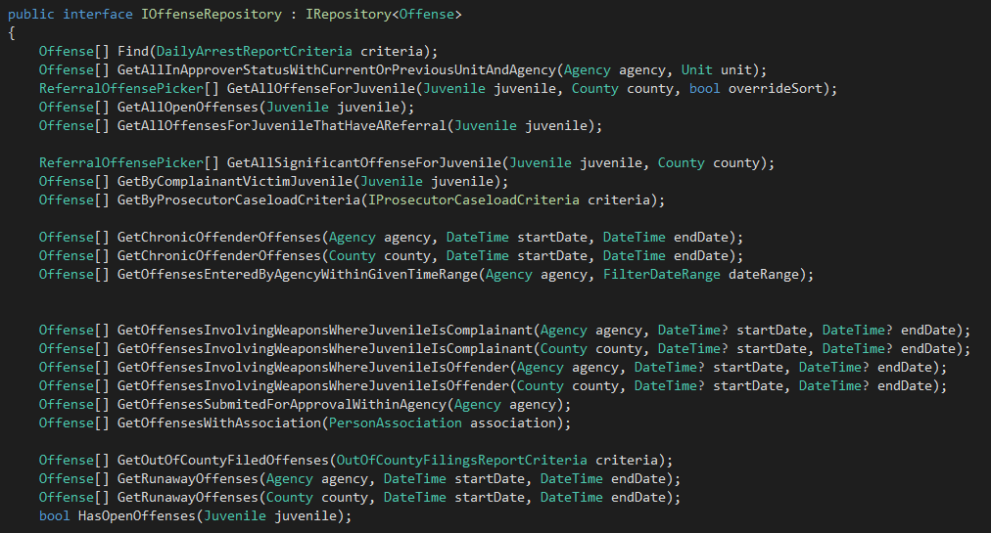
Pattern Happy

Slide 18
Lesson 5: Structural Patterns least important part of DDD

Slide 19
Final tally
195 controllers
652 actions
121 roles
218 entities
184 value objects
352 enumerations
~50 counties deployed

Slide 20

Majestic Monolith Myth

Slide 21
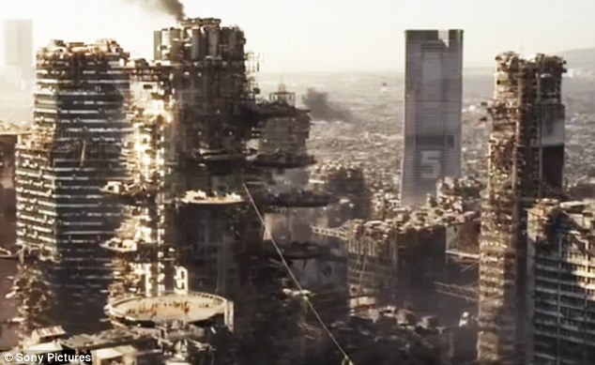
Reality

Slide 22
Part 2: The Do-over

Slide 23
Project Background
Too expensive/costly/risky to build single system
Focus one agency at a time
Start with prosecution

Slide 25
Built around bounded contexts
Prosecution
LEA
Cases
Dockets
Defense
Workflow
Grand Jury
Indigent Defense
Courts

Slide 26

Oh, that piece of ?

Slide 27
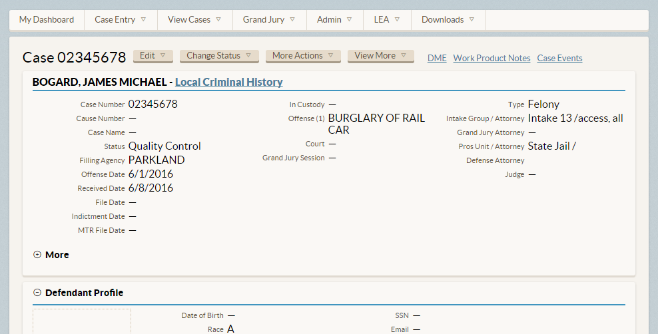
Building case-centric system

Slide 28
Lesson 1: Cohesiveness brings clarity and deeper insight

Slide 29
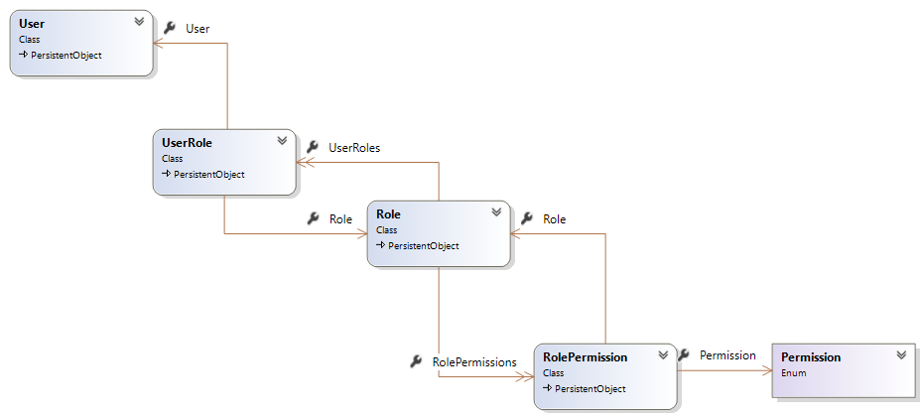
Modeling Roles and Security

Slide 30
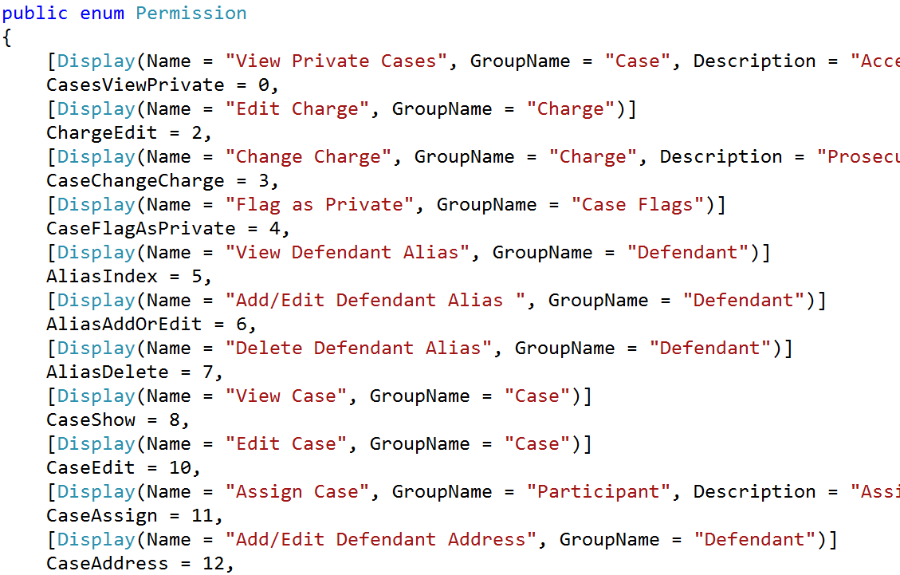
Granular, task-based permissions

Slide 31
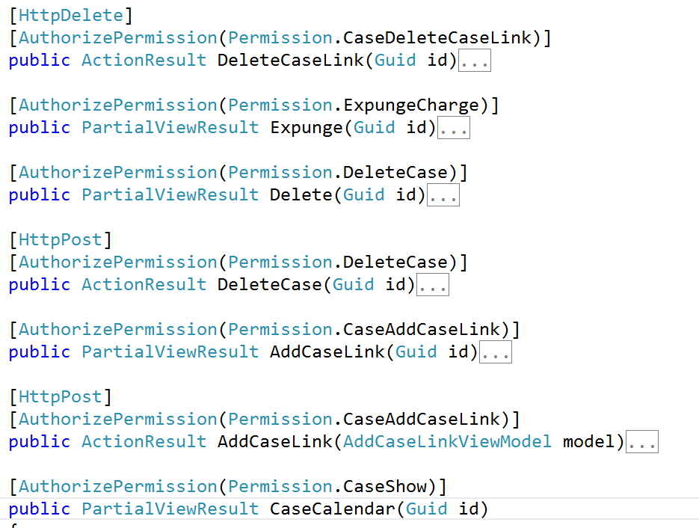
Associating permissions

Slide 32
Lesson 2: Flexible in places, rigid in others

Slide 33
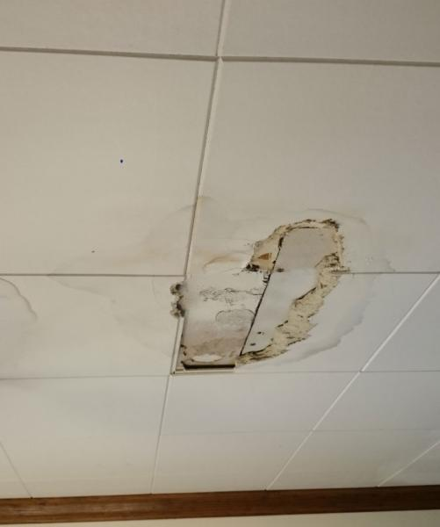

The File Management Problem

Slide 34
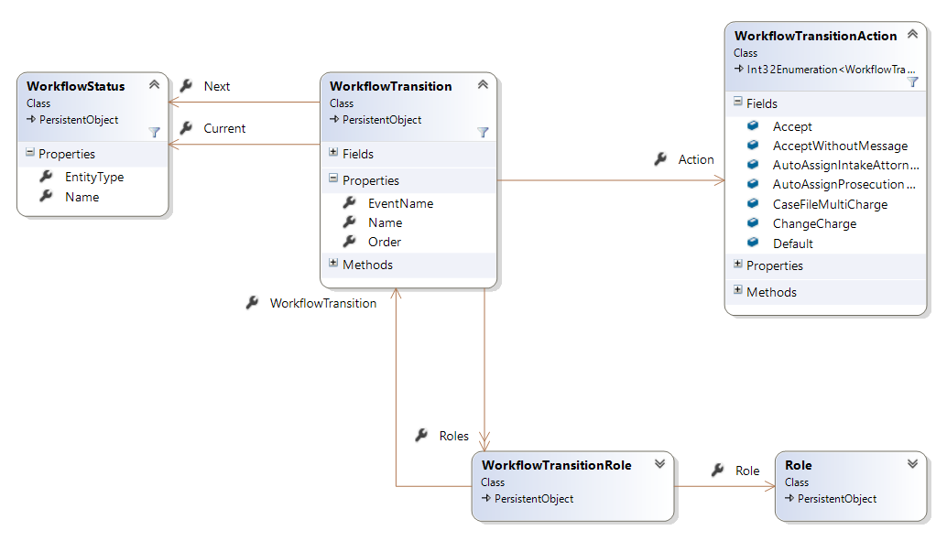
Modeling Flexible Workflows

Slide 35
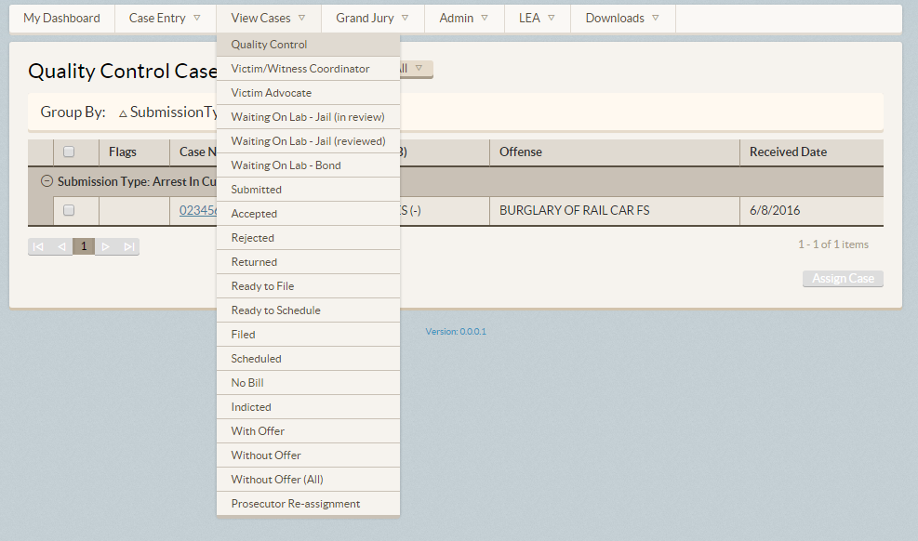
Driving work via queues

Slide 36
Lesson 3: Sometimes the model needs a model

Slide 37
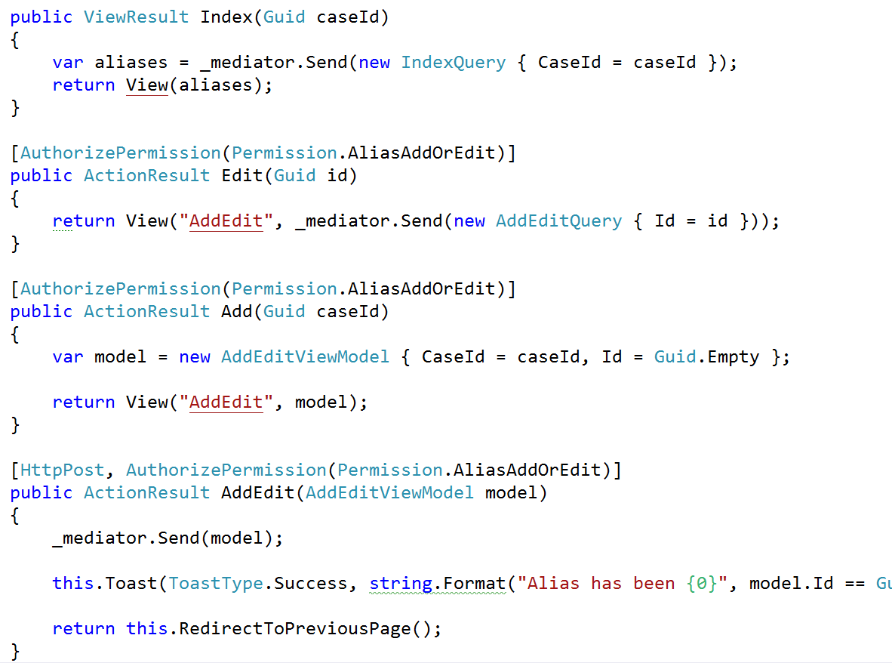
Ditching patterns

Slide 38
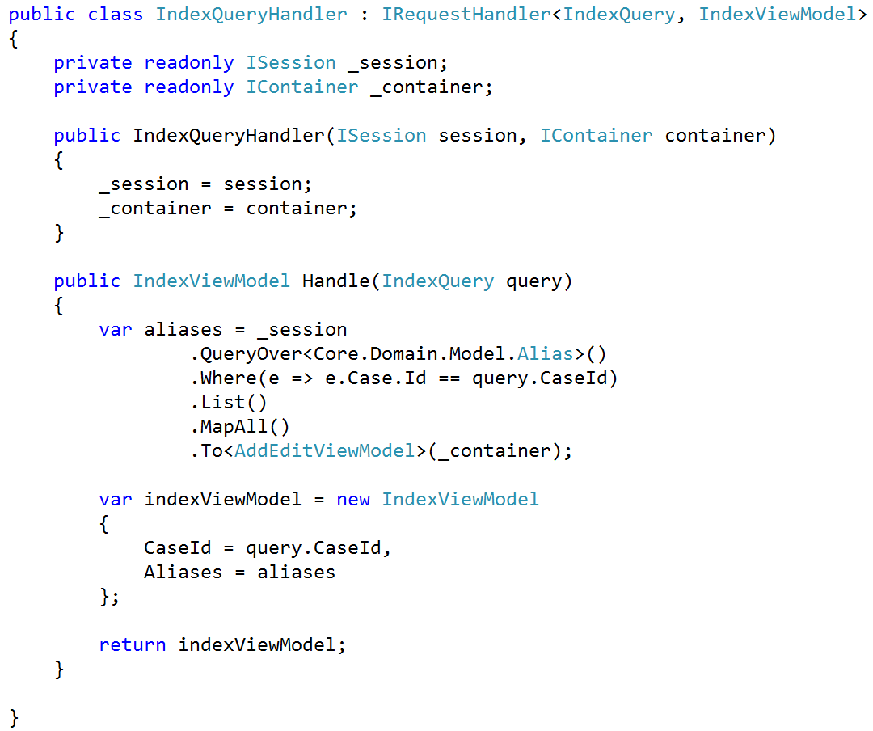
Ditching abstractions

Slide 39
Lesson 4: Don’t blindly follow pattern advice
But CQRS is lovely

Slide 40
Dealing with others
Defense
Prosecution
Portal
LEA
LEA Portal
Cases
Defense API
Dockets
Workflow
Grand Jury
Indigent Defense
Courts

Slide 41
Lesson 5: Microservices and anti-corruption layers are your friend

Slide 42
Final tally
70 controllers
600 actions
239 permissions
139 entities
0 value objects
80 enumerations
~20 counties deployed

Slide 43


Slide 44
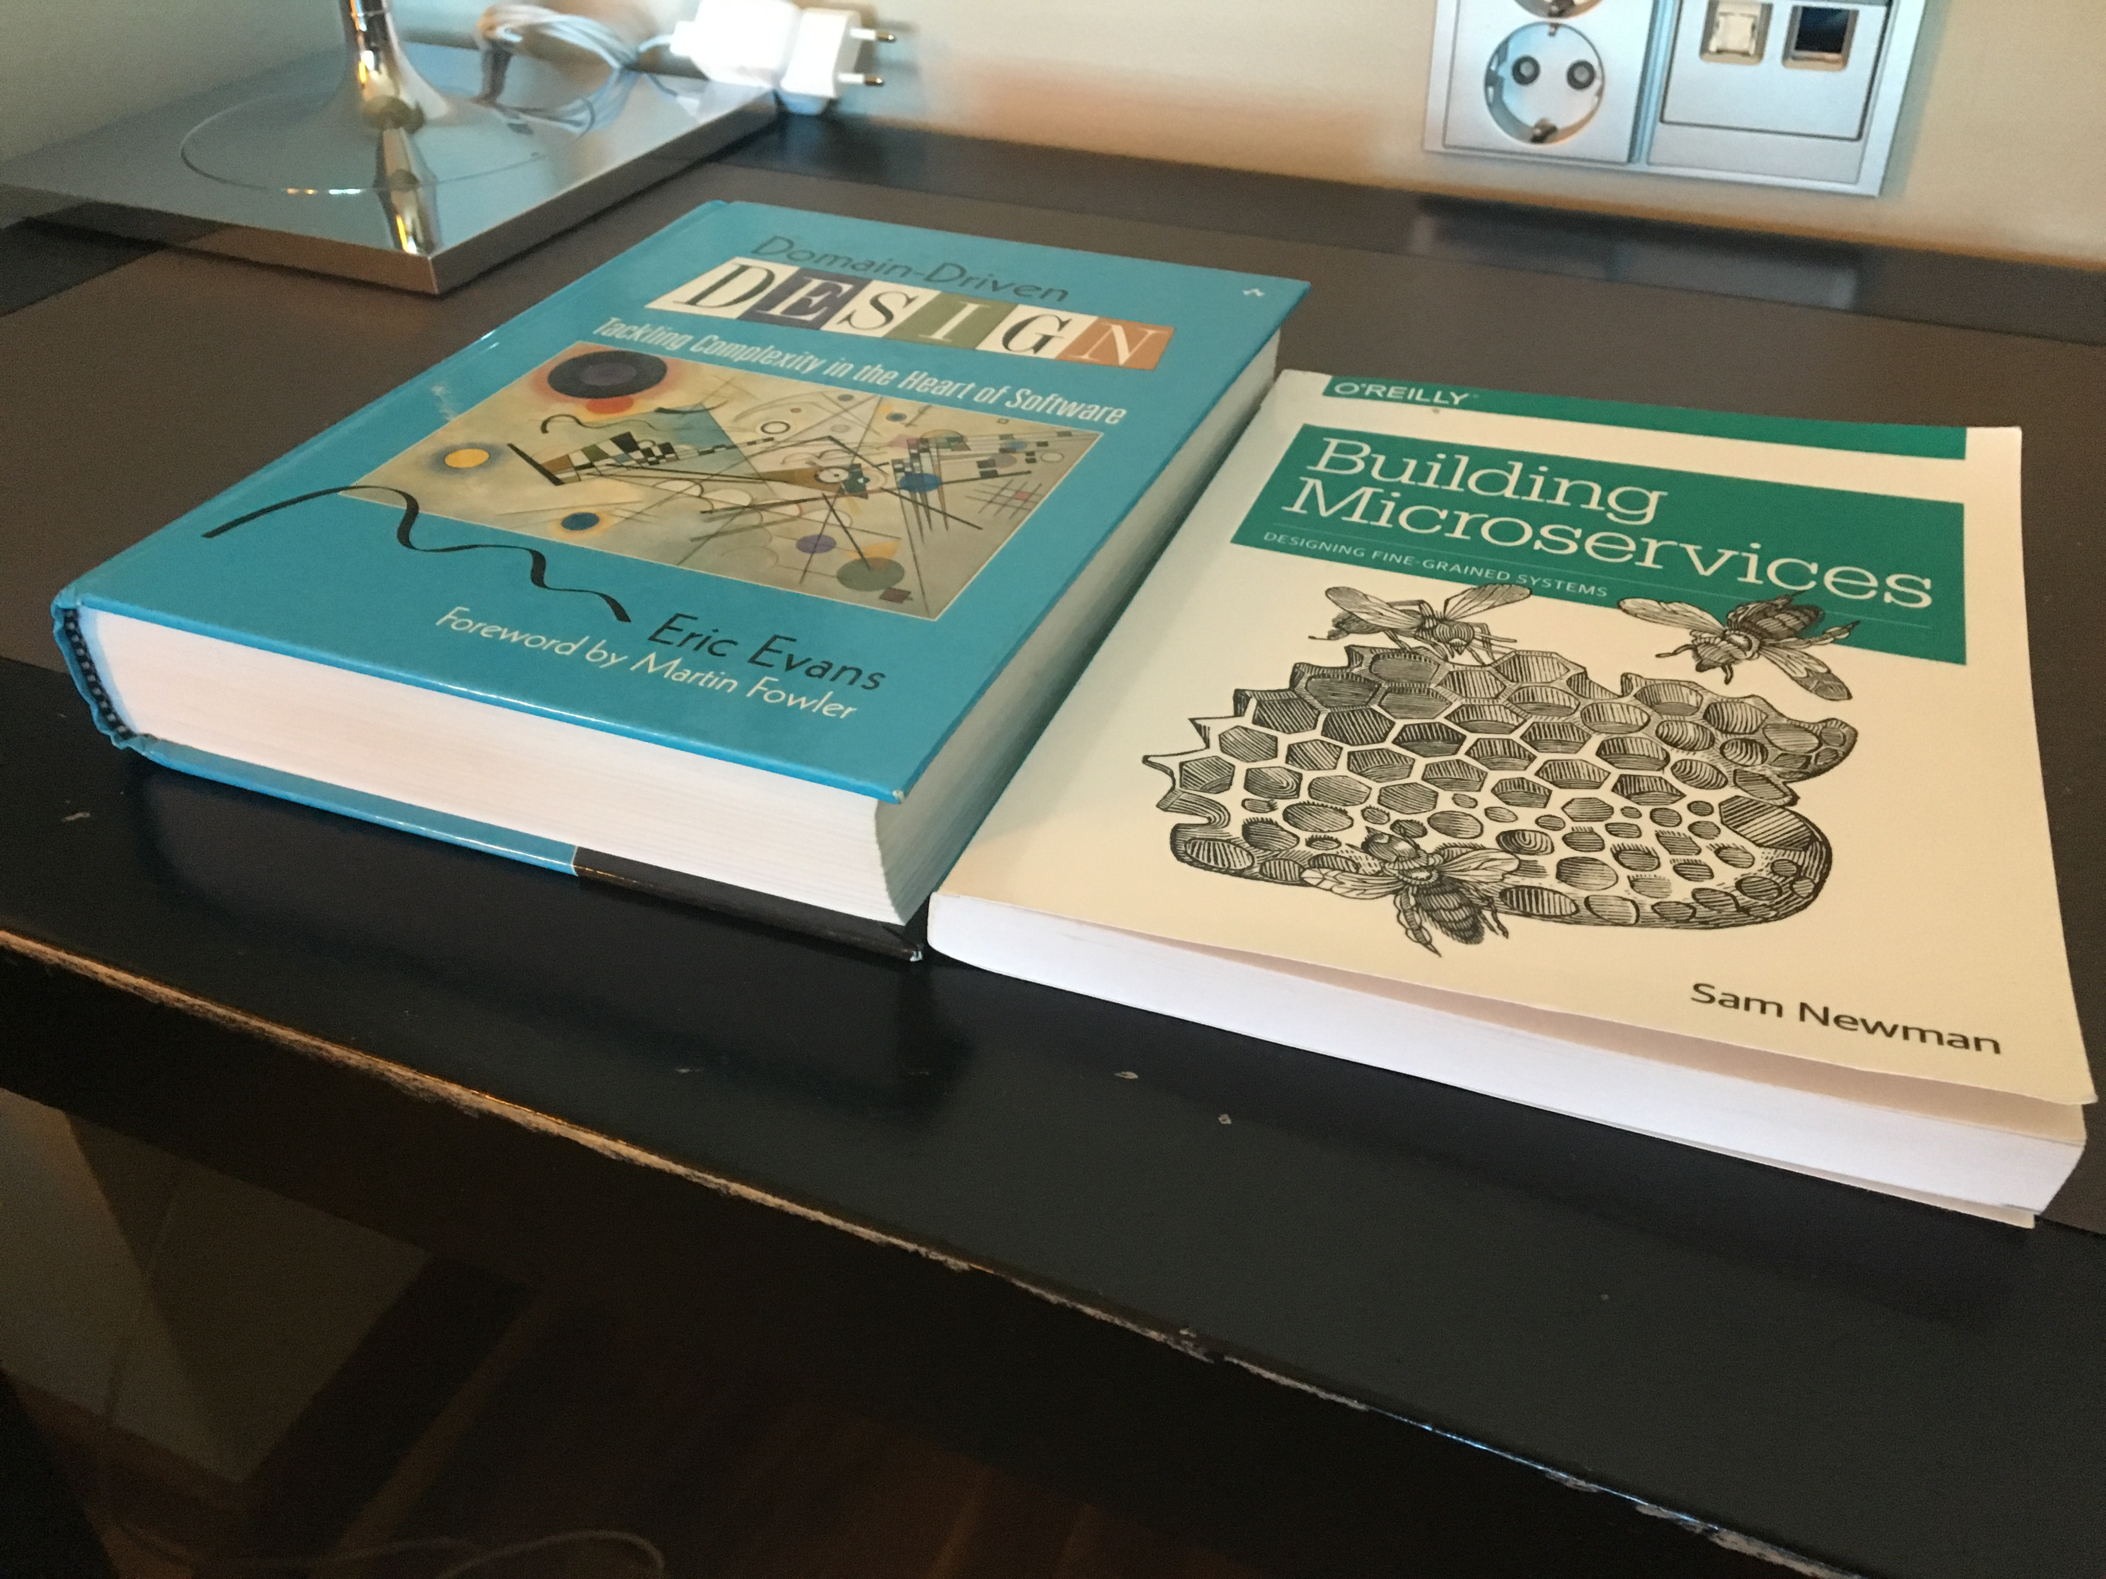

Slide 45
Domain-Driven Design: The Good Parts
Jimmy Bogard
@jbogard
github.com/jbogard
jimmybogard.lostechies.com

